Slide 1
Financial data analysis

Slide 2
Problem statement
Without analyzing the competition, it is difficult for a business to survive. You are tasked to analyse the competition for the management to provide better results. This data set has information on the market capitalization of the top 500 companies in India. Serial NumberNameName of CompanyMar Cap – CroreMarket Capitalization in CroresSales Qtr – CroreQuarterly Sale in crores
This project aims to perform the following task:
ETL: Extract-Transform-Load some Amazon dataset and find for me Sales-trend -> month-wise, year-wise, yearly-month-wise.
Finding key metrics and factors and show the meaningful relationships between attributes.

Slide 3

Attributes of dataset
Name(of Companies)
Sales-Otr(quaterly sales)
Mar – Cap(market capitalization)

Slide 4

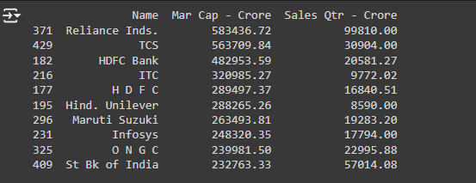
From given financial data, after sorting the data for top 10 companies with maximum market capitalisation, following are the obtained results:

Slide 5
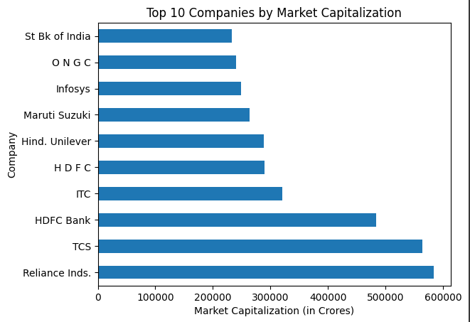

Slide 6
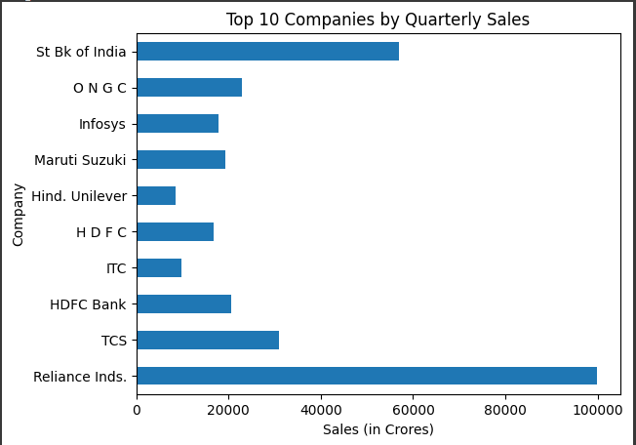

Slide 7
For further insights we have scatter plots with line of regression and threshold calculated for cubic polynomial.
The threshold value represents the market capitalization level beyond which quarterly sales tend to increase significantly.
Why cubic model?
Cubic models are often more flexible than quadratic models, but less prone to overfitting than higher-degree models like quartic or quintic.
By selecting the cubic model, it is likely to get a better generalization of the data, and the threshold value it provides should be more reliable.
Experimental results:
In model with degree 4 polynomial regression line does touch some points on the scatter plot, but doesn't intersect them perfectly. This suggests that the model is capturing the general trend of the data, but might not be fitting each point exactly.
Degree 3 (Cubic):
Threshold value 380669, this means that quarterly sales tend to increase significantly when market capitalization exceeds this value.
- This value is lower than the quadratic model's threshold, which might indicate that the cubic model is capturing a more complex relationship and avoid overfitting.

Slide 8
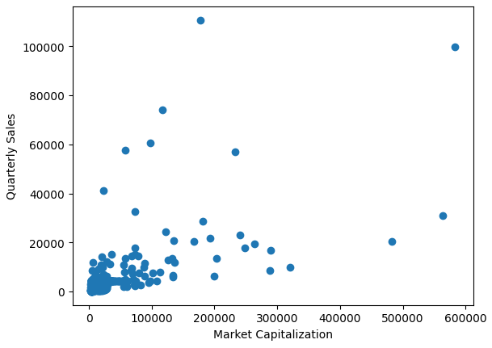

Slide 9
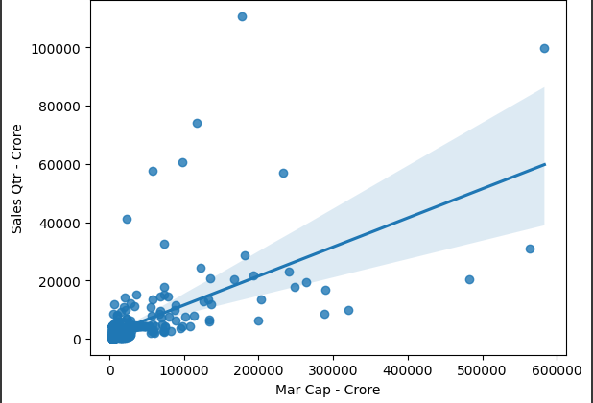
Line of regression with Degree 1, Threshold value -8029
- This suggests that the linear model doesn't capture the relationship well, as the threshold value is negative and doesn't make practical sense.

Slide 10
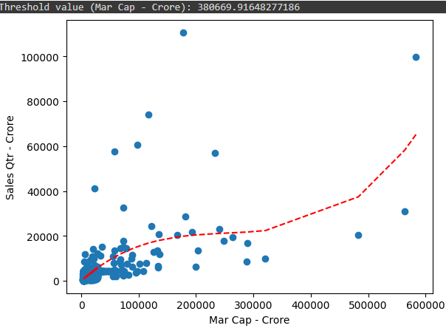
Best Scatter Plot with Degree 3

Slide 11
For further insights we have calculated coefficient of correlation and coefficient of determination.
Correlation coefficient (0.61):
- Indicates a moderate to strong positive linear relationship between market capitalization and quarterly sales.
- As market capitalization increases, quarterly sales tend to increase as well.
- Coefficient of determination (R^2) (0.37):
- Suggests that about 37% of the variation in quarterly sales can be explained by the variation in market capitalization.
- This means that while there is a significant relationship between the two variables, there are still other factors influencing quarterly sales that are not captured by market capitalization alone.

Slide 12
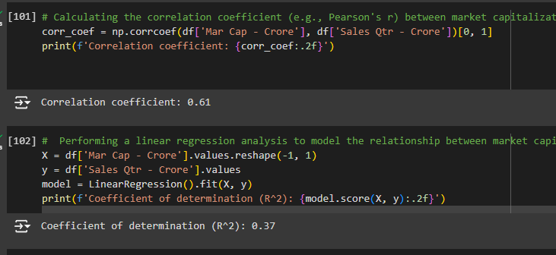

Slide 13
Lastly to finish up we have a decision tree. Here we have split the data into training and test sets and trained the model.
Tree plot displays the following parameters for each node:
1. Mar Cap-Crore: This is the feature (or attribute) being used to split the data at this node. In this case, it's the market capitalization in Crores.
2. Squared Error: This is the measure of impurity or variance in the target variable (Quarterly Sales) for the samples in this node. A lower value indicates more homogeneous samples.
3. Samples: This represents the number of data points (samples) that fall within this node.
4. Values: This shows the distribution of the target variable (Quarterly Sales) for the samples in this node. It's usually represented as a list of values, where each value corresponds to a specific class or range of values.

Slide 14
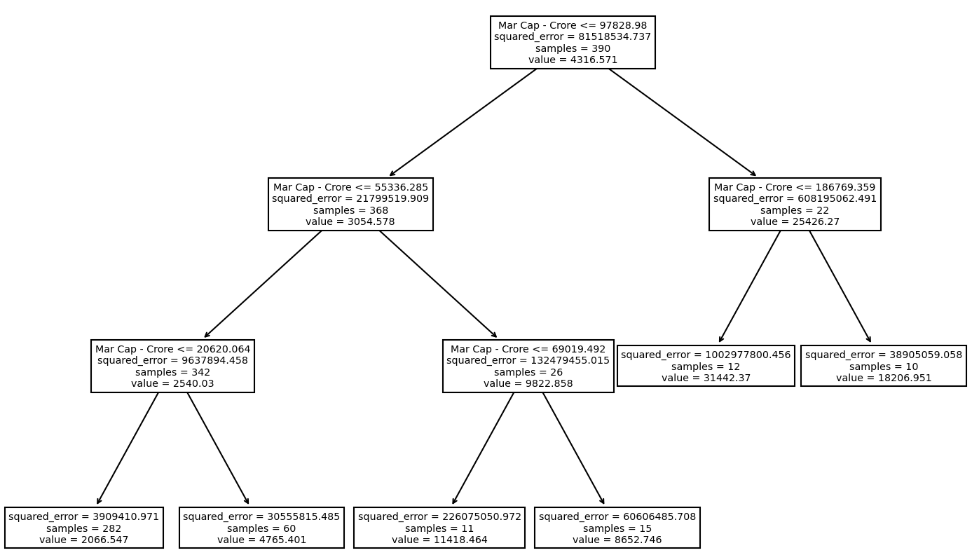

Slide 15
Thank you

